Slide 1

Crop Prediction Using Machine Learning
Vardhaman College of Engineering Department of Information Technology
Mini Project
Batch Number:15
Guide: Mr B.Ravinder Goud
Team:
17881A1213 – J karthik Reddy
17881A1224 – R Pradeepthi
17881A1204 – G Anush Reddy

Slide 2
PROBLEM SCOPE:
In our country large amount of population are depending on agriculture though government is taking financial steps to help farmers still they are facing problems due to lack of data anlaysis and prediction on crops
Our objective is to develop an application using machine learning for predicting which crop to be used based on soil condition using "k nearest neighbor classification".

Slide 3
Abstract
Agricultural monitoring, in particular in developing countries,can help prevent famine and support humanitarian efforts. A central challenge is yield estimation, which is to predict crop yields before harvesting.
We introduce a scalable, accurate, and inexpensive method to predict crop yields using publicly available remote sensing data. This solution if implemented at the soil health centers which have been set up by the government could help all the farmers to use minimum fertilizers, so as to maintain the soil health and also would provide them an opportunity to gain at most revenue from the same piece of land.
Predictive analysis to suggest the top three more suitable crop based on the nutrition levels of the soil, temperature and also the expected revenue that this particular crop could generate.

Slide 4
EARLIER WORK:
Remote sensing data has been widely used for predicting crop yield in the remote sensing community (Bolton and Friedl; Johnson). However, all existing approaches we are aware of rely on hand-crafted features, on the assumption that they can capture most of the information related to vegetation growth contained in high dimensional images.

Slide 5
PROPOSED SYSTEM
Inspired by recent successes in computer vision and speech recognition and in contrast to existing approaches.

Slide 6
Objectives:
Farmers can know which crop is feasible based on their soil type.
Chances if increasing income for farmers based on analysis.

Slide 7
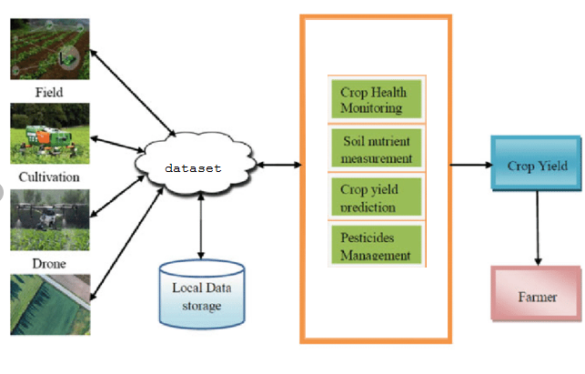
Architecture

Slide 8
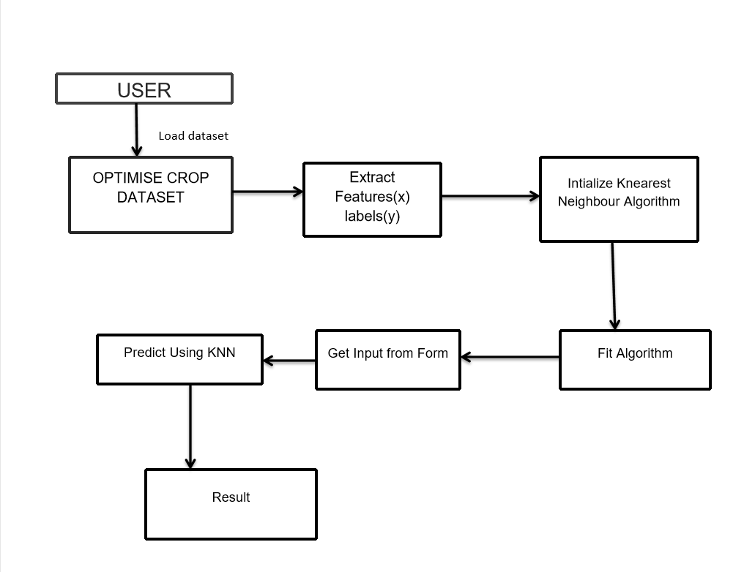

Slide 9
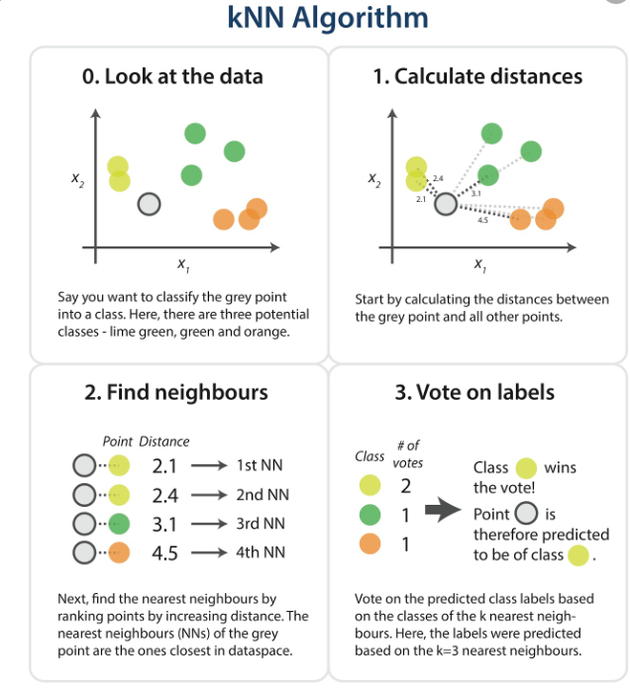

Slide 10
The KNN Algorithm:
Load the data
Initialize K to your chosen number of neighbors
3. For each example in the data
3.1 Calculate the distance between the query example and the current example from the data.
3.2 Add the distance and the index of the example to an ordered collection
4. Sort the ordered collection of distances and indices from smallest to largest (in ascending order) by the distances
5. Pick the first K entries from the sorted collection
6. Get the labels of the selected K entries
7. If regression, return the mean of the K labels
8. If classification, return the mode of the K labels

Slide 11
Advantages of KNN Algorithm:
The algorithm is simple and easy to implement.
There’s no need to build a model, tune several parameters, or make additional assumptions.
3.The algorithm is versatile. It can be used for classification, regression, and search .

Slide 12
Explore, clean, and prepare the data:
Wherever we obtained our data, there may be some things wrong with it that we need to correct to prepare it for the KNN algorithm. For example, the data may not be in the format that the algorithm expects, or there may be missing values that we should fill or remove from the data before piping it into the algorithm.
Our KNN implementation above relies on structured data. It needs to be in a table format. Additionally, the implementation assumes that all columns contain numerical data and that the last column of our data has labels that we can perform some function on.

Slide 13
Steps :
Get Soil values from User.
Load the Dataset values.
Match the Crop
Analyze the Fertilizer
Display the predicted Crop Information
Display the Fertilizer Information

Slide 14
Technology:
(machine intelligence and data analytics)
Programming language : Python
IDE : Anaconda Prompt

Slide 15
Farming is a profession of hope.
-Brian Brett
Thank You

